Slide 1

STUDENTS IQ AND GPA
MACHINE LEARNING FINAL
EILEEN SPENCER
SPRING 2022

Slide 2
THE PROBLEM
PROBLEM:
How do we know how a student’s IQ score impacts their grades or GPA in college? Maybe we don’t. This analysis looks at the correlation between those variables.
This is relevant information because it can help understand how a student might perform in school given their IQ score or if it even matters.
This can help understand how any outside factors impact students more than their inherent “smartness”

Slide 3
THE APPROACH
APPROACH:
Using a dataset with 200 college student’s information, with both IQ scores and cumulative GPAs, I wanted to see if students with high IQ scores also had high cumulative GPAs
I broke down the data into “higher than average IQ” with scores above 115 and “higher than average CGPA” with a value of 6.98 or more
I then saw how many students met the criteria for both variables, both independently and separately using a Naïve Bayes approach with probability calculations.

Slide 4
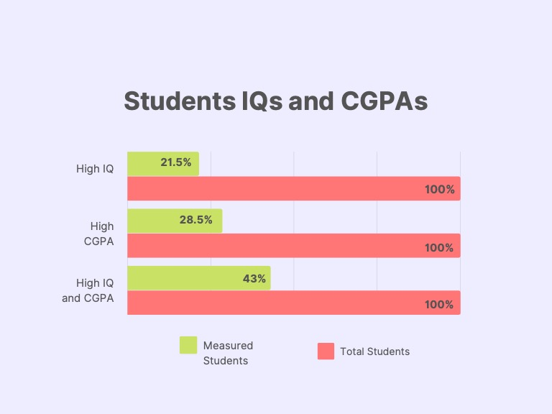
CONCLUSIONS
Of the 200 students in the dataset, 43 (21.5%) were reported to having above average IQs, or a score of 115 and over.
Of the 200 students in the dataset, 57 (28.5%) were reported to have a higher-than-average CGPA, or 6.98 and above.
Of the 200 students in the dataset, 86 (43%) students had both an above average IQ and an above average CGPA.
The findings from this analysis show that less than half the students with higher-than-normal IQs had higher than normal CGPAs. More research would need to be done in this sector to tell us more, however this is a good idea as to how external factors can impact the performance of students in higher education. This information would be very helpful to universities and schools across the country to prove how important other dynamics in a student’s life can impact their ability to learn and focus.
"College Student Data". Kaggle.Com, 2022, https://www.kaggle.com/datasets/kuchhbhi/cpga-iq-placement. Accessed 5 May 2022.
"Do You Have A Genius IQ Score?". Verywell Mind, 2022, https://www.verywellmind.com/what-is-a-genius-iq-score-2795585. Accessed 5 May 2022.

